Slide 1
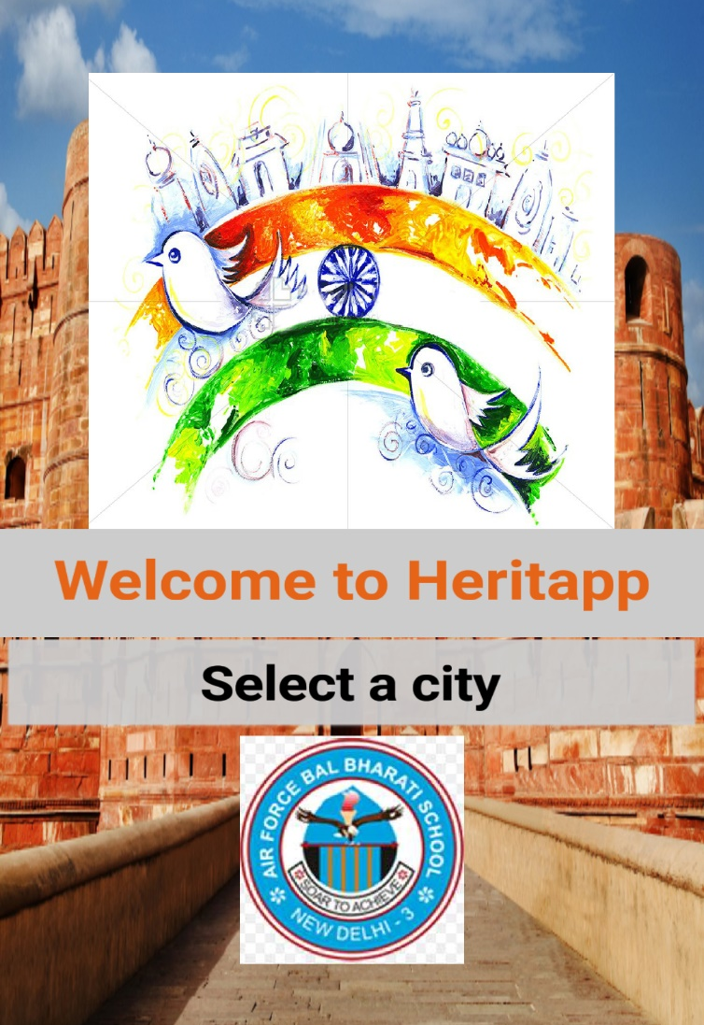
HACK OVERFLOW

Slide 2
Problem Statement
HOW CAN WE USE TECHNOLOGY TO HELP RESIDENTS & VISITORS CONNECT WITH THE HISTORY AND BUILT ENVIRONMENT OF INDIA?
These days people are forgetting about their old culture and heritage.
They do not care about what happened that resulted in how everything is now. We look forward to making them realise it.

Slide 3
About the project
The project will aim at illustrating the important historic events and monuments of the past that once happened in the vicinity of the selected area.
The user can choose between various tabs like architecture, politics, religion, cuisine, culture, etc.
On selecting one of the above tabs, the user will be redirected to a new screen where he can navigate through all the information available about that particular tab provided in an easy to understand way with use of pictures and illustrations.

Slide 4
Target Audience
Local Residents: Local Inhabitants will be keen to know more about their heritage, which will be just a click away. This app will be an extremely useful tool for them to learn more about their own home town.
Foreign and Domestic Tourists: Tourists will find this application to be extremely useful for sightseeing as well as learning about the local culture.
Students: This application can prove to be very useful for students wishing to learn about local heritage especially if they don’t have frequent access to an internet connection

Slide 5
Business Model
This app will be crowd sourced.
We have decided to keep this app free of cost.
It will allow users to find out more about their own heritage
The data will be available offline, however for extra information users will require an internet connection

Slide 6
Scopes of Improvement
We can add Multi-Lingual support
Information on more cities
Making a more interactive interface
Creating a more user-friendly interface
Additional information on cities

Slide 7
Additional information
Data taken from:
whc.unesco.org
tourism.gov.in
en.wikipedia.org
Project created by:
Aryan Madaan
Daksh Sansanwal

